Slide 1

Cyber Security Threat Model
Secret Server Password Exchange
February 2025

Slide 2
Executive Summary
Low
Risk
The Cyber Security team has reviewed the password exchange process, assessed potential security risks and implemented strong controls to mitigate them.
Measures such as restricted Salesforce access, controlled script execution, strict account permissions have been put in place.
Based on this review, the Cyber Security team deems the process secure and approves it for sign-off.
Cyber Security Threat Model Sensitive

Slide 3
Threat Model Details
Entity Under Review
Name
Secret Server Password Exchange
Description
This project ensures secure password management for service desk users in the iTrent environment. By automating the password exchange process via Salesforce and Secret Server, it eliminates direct access to credentials and attempts to empower the customer in the password exchange process.
Risk Impact
Moderate
Credentials travelling over trust boundaries
Scope
The threat model reviews the new threats of the Secret Server Password exchange service between Salesforce, Secret Server and Itrent.
Key Stakeholders
Robin Price
Head of Change and Systems – Managed Services
Duncan Waite
Cloud Services
Quality Assurance
Security Consultant
David Biayna Neal
05/02/2025
Security Review Meeting
Trefor Walters, Will North
06/02/2025
Approved by
Will North
10/02/2025
Cyber Security Threat Model Sensitive

Slide 4


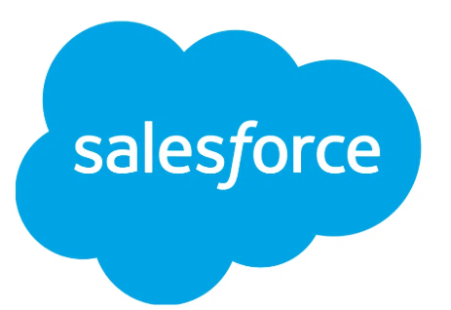
Threat Model
Cloud Services
T02
5. Credentials are checked in and updated in secret server for specific user and environment through another API
T03
3. Api used to pick up the request from salesforce
Automate Workflows
MS-SVR4552
Pam.webitrent
Sectet Server
2.Customer fills secure password exchange request via salesforce portal for specific Itrent User.
T01
Customer
4. Powershell script runs via scheduled task every 1h looking at the requests on salesforce
T04
6. Credentials synchronised / updated in Itrent environment
Customer Itrent Environment
1.Customer logs into Itrent environment and sets a new password for a specific user.
Cyber Security Threat Model Sensitive

Slide 5
Mitigating Controls
Threat Ref. | Threat Description | Control Design | Control Owner | Control Mitigation Effectiveness | Threat Mitigation
T01 | Malicious actor gets a foothold into Cloud Services network due to having compromised the API user which doesn't have restricted permissions. | The calls into Salesforce are governed by a Salesforce user profile with tokenised authentication. Automate team are in the process of defining a new Salesforce “Integration Account” with limited access to only the objects that are require for the password exchange process. | Automate Team | Effective | Sufficient Mitigation
T02 | Malicious actor compromises Automate server and is able to make changes to the PowerShell script that runs via the scheduled task and change is function to do something malicious such as dumping the secret server secrets. | The Automate tasks run as MSMAS\automate_user: This is a member of the Remote Desktop Users group across all Automate agent servers (not admin level access). It also has limited access to some file shares which are required for completion of the jobs it runs. The script is run by a specific user “Automate_User” which is the only one to have access to the Secret Server credentials when using API calls to synchronize the password. All members of the “Automate Team” have access to the code in the script The team follows a development path with reviews before code is made live. All members are NPPV checked. | Cloud Services | Effective | Insufficient Mitigation
T03 | Malicious actor compromises the AD account that runs the scheduled task on the automate server. This would give full access to Secret server , automate and any other resource that depends on that account. | The user used to connect to Secret Server is MSMAS\ss_credmanagement. This has no domain permissions and is purely used to connect to the Secret Server API using Windows authentication; this is for management of secrets. The scripts access credentials for ss_credmanagement from Secret Server using the automate user, and the use those credentials to manage the secret content to update the password field value. That way, Cloud Services have "RBAC'd" the capability to manage the very specific folder structure in Secret Server that has been setup. The account can be setup for enhanced monitoring and alerting. | Cloud Services | Effective | Sufficient Mitigation
T04 | Malicious insider ie Service Desk User intercepts password by using Dev Tools where the environment password is displayed in plain text. | A user can see the password in plain text via the browser's developer tools, however the access will be lost due to MFA implementation. | N/A | Effective | Sufficient Mitigation
Cyber Security Threat Model Sensitive

Slide 6
Control Weaknesses
Action Ref. | Control Weakness | Threat | Recommendation
A01
Cyber Security Threat Model Sensitive

